Slide 1

Bottle Rocket
Group 12
Jashan Chopra
Dominic Dougherty
Sasha Kryuchkov
Sebastian Urrunaga
Jacob Weiner

Slide 2
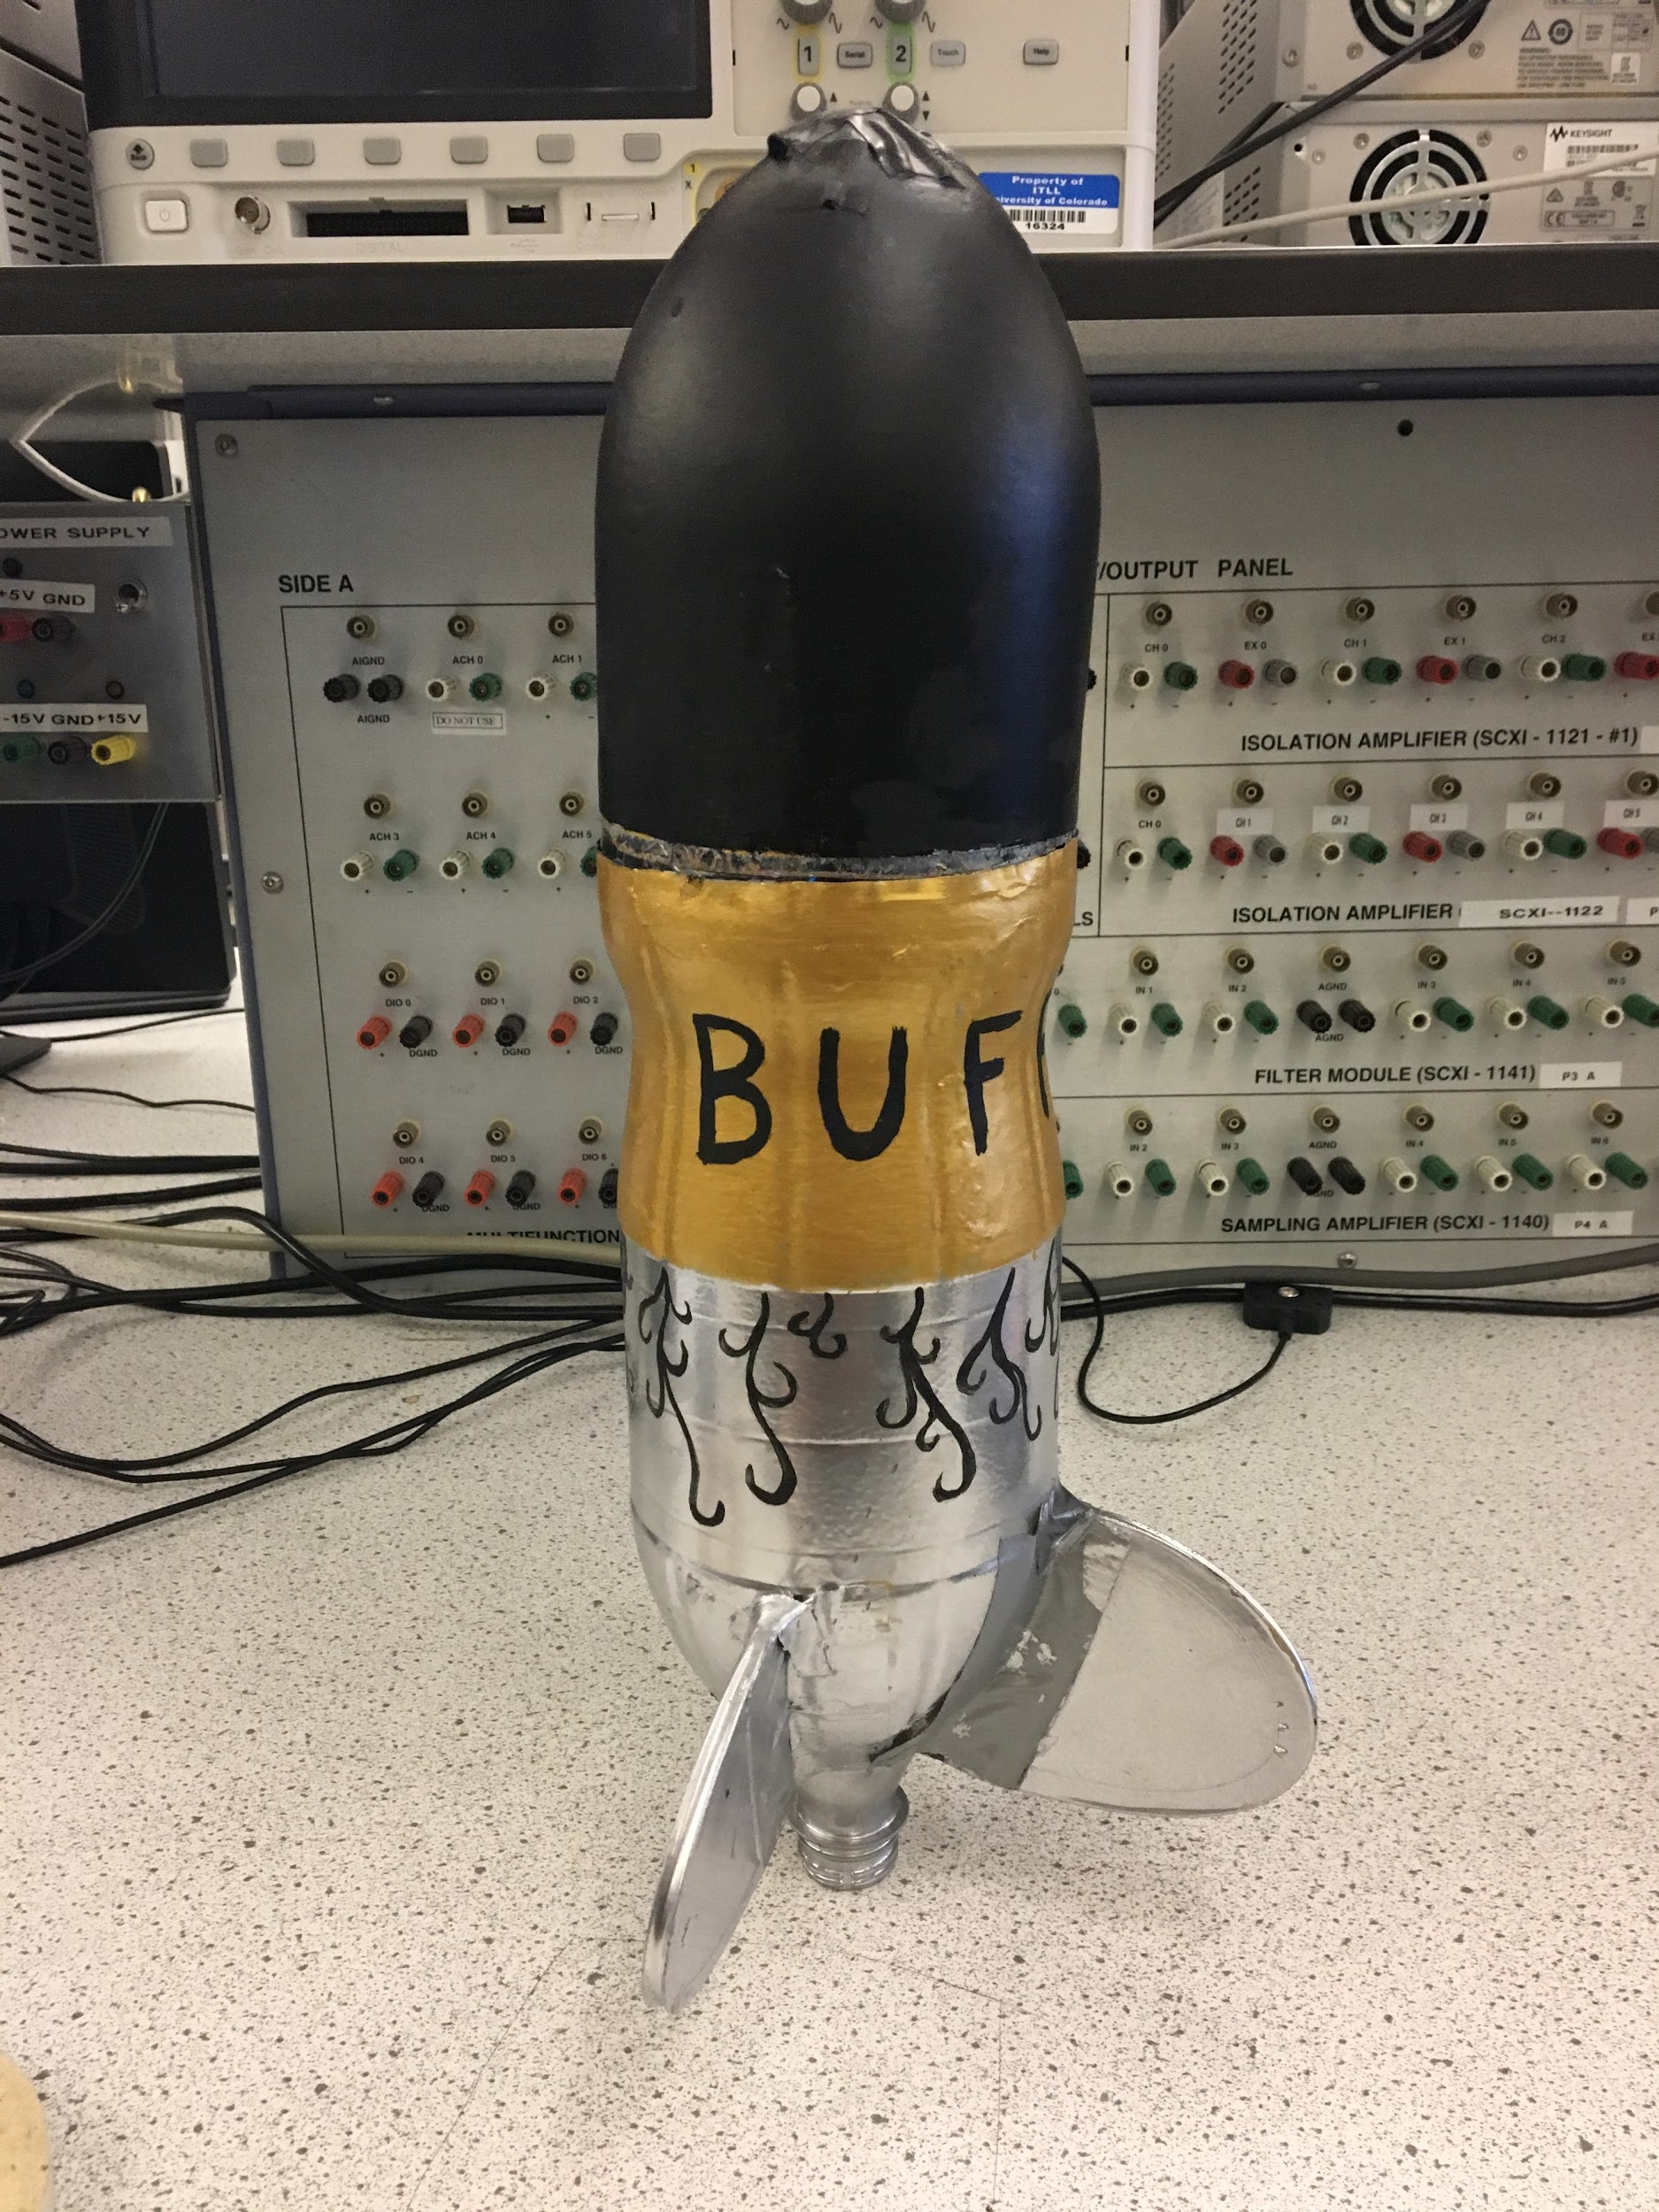
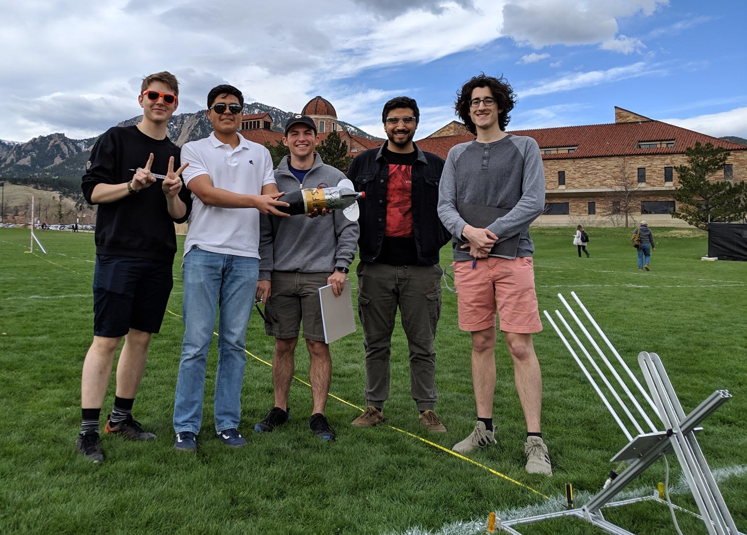
Overview and Goals
Develop an accurate prediction of the bottle rocket
Learn and understand the steps associated with development and design
Learn and experiment with different designs

Slide 3
Characterizing TA Test Launch
Baseline Parameter | Baseline Value
CG // CP | 0.23 meters from the cap of the bottle
Initial Mass // Final Mass | 1079 grams // 125 grams
CD | .3361
Thrust | From Static Test → Mean = 59.4 [N], SD = 55.64 [N]
Isp // DeltaV | 1.144 [s] // 22.8292 [m/s]
Swing Test Met Expectations | Yes
Launch Angle | 45 degrees
Notes:
The team characterized the TA Test launch in this slide. Coefficient of drag data was found from the wind tunnel testing, the specific method of which will be discussed later. Thrust came from the static test stand data, and ISP / DeltaV was interpolated from this. The standard deviation of the thrust data should be noted, it ranges heavily in a sinusoidal fashion which we will look at closer down the road.

Slide 4
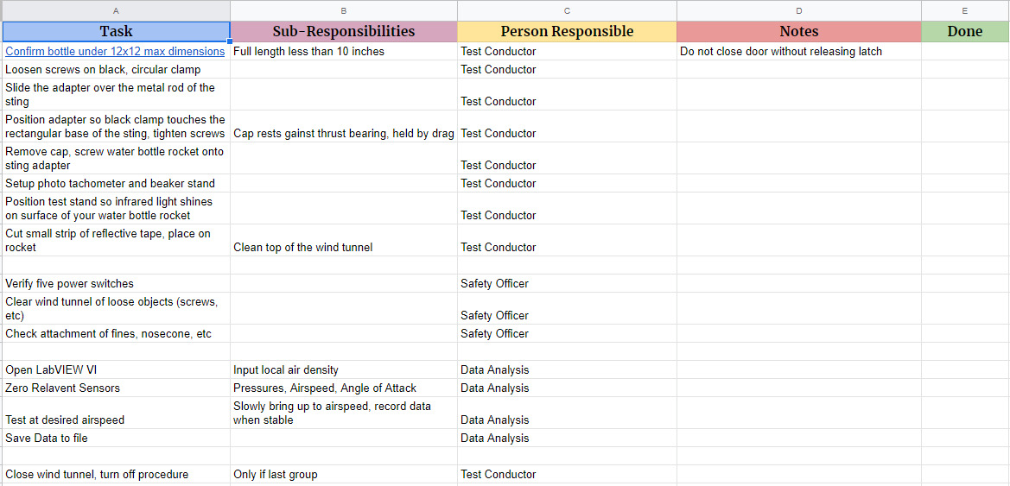
Checklist Development
Notes:
Initially, each team member developed one of the multiple checklists. The checklists were divided into the individual tasks and then the sub responsibilities. Each task was designed by team member responsible, with notes and a done column for checking things off. Addition systems engineering tasks were setup, including a timeline and calendar, along with team member roles.
Seb

Slide 5
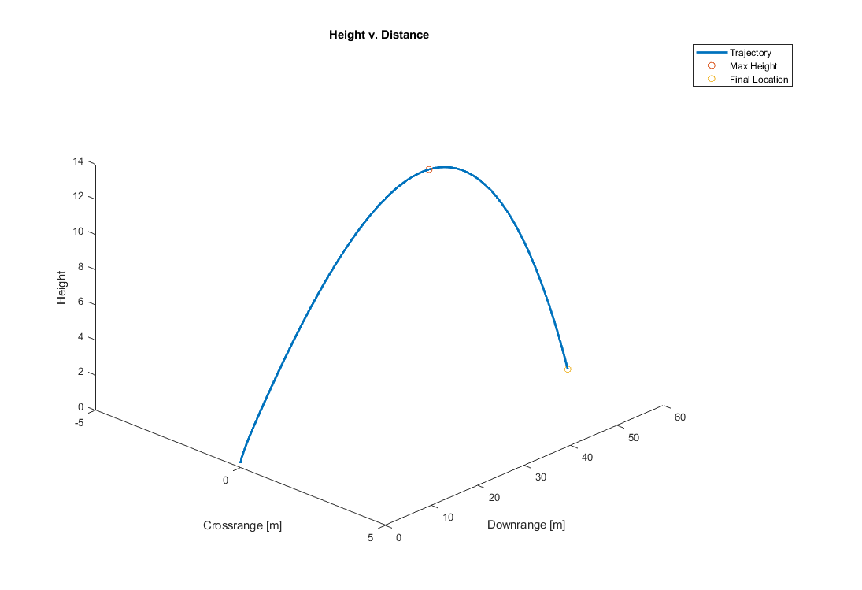
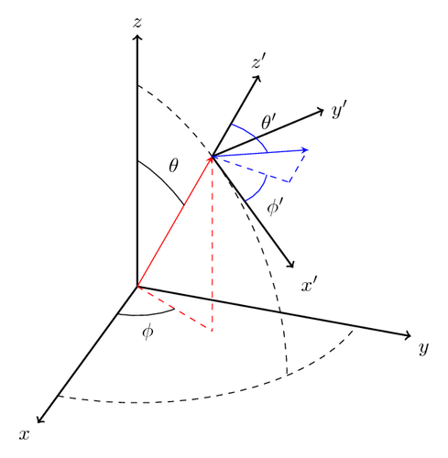
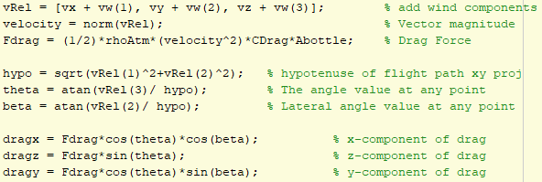
Thermodynamic Model
Relative wind velocities
Euler angle calculations
3D plotting
Notes:
Jashan: The thermodynamic model was adjusted from the 2012 code with respect to wind and the instantaneous angle calculations. To incorporate wind effects, a vector of the wind velocities was inputted into the state vector. To figure out the initial relative contributions of the wind in both the crossrange and downrange directions, the angle between the wind vector and the relative direction vector was found and the wind was projected onto the direction using a dot product. The relative velocity in each xyz direction was calculated, and the magnitude was taken for use in drag calculations. The angles at each point were calculated from the instantaneous accelerations using Euler’s angles.

Slide 6
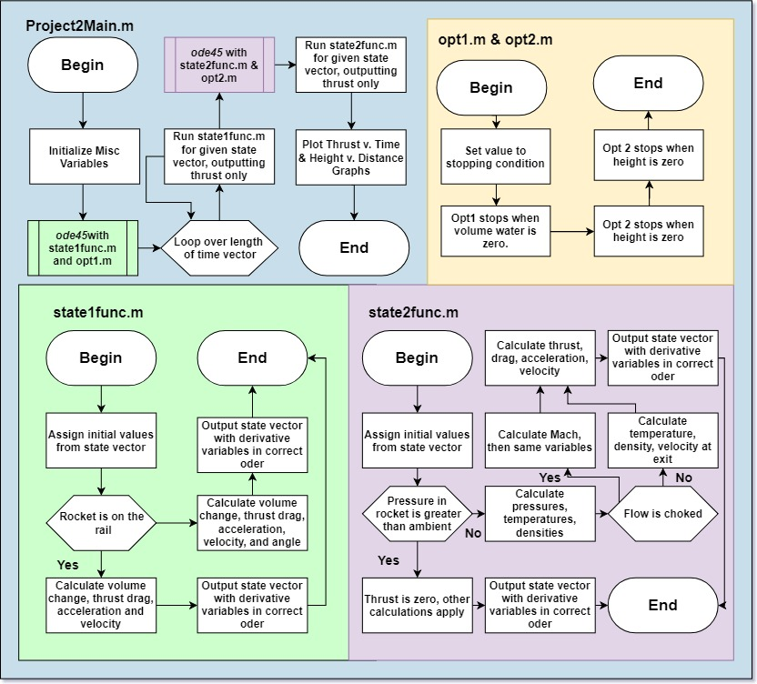
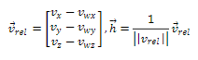
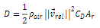
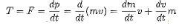
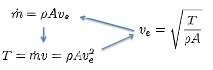
Thermodynamic
Model Flowchart
Thermodynamic Equations

Slide 7
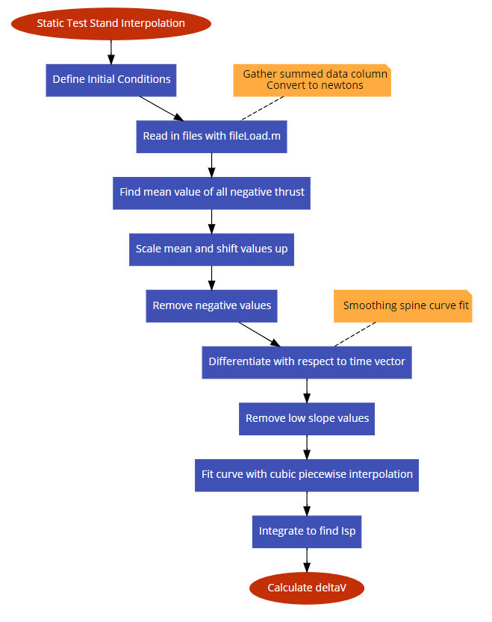
Isp Rocket Equation Model
Trimmed data values by setting tolerance on slope values, shifting up by mean of negative values, and removing zeros post shift
Integration of thrust using fitmodel and trapz returned same results → calculated Isp and deltaV
Smoothingspline worked best for slope tolerance check, cubicinterp worked best for actual thrust data
Notes:
Jashan: The Isp Rocket Equation Model calculates the deltaV produced by the rocket and assumes that this is the instantaneous velocity at launch. The thrust data is found from the static test stands performed in class. The graphs in this picture show the TA initial static test stand data, which has been modified for analysis purposes. The misc values before and after the crucial period were removed by calculating the instantaneous slope at each point of the fit model and then deleting those values. There was a debate about removal of negative force values or shifting up of these values. Directly shifting by the most negative value produced extreme results. A compromise of taking the mean of just the negative values and shifting it up by that, then removing any leftover negative force values was the end solution.

Slide 8
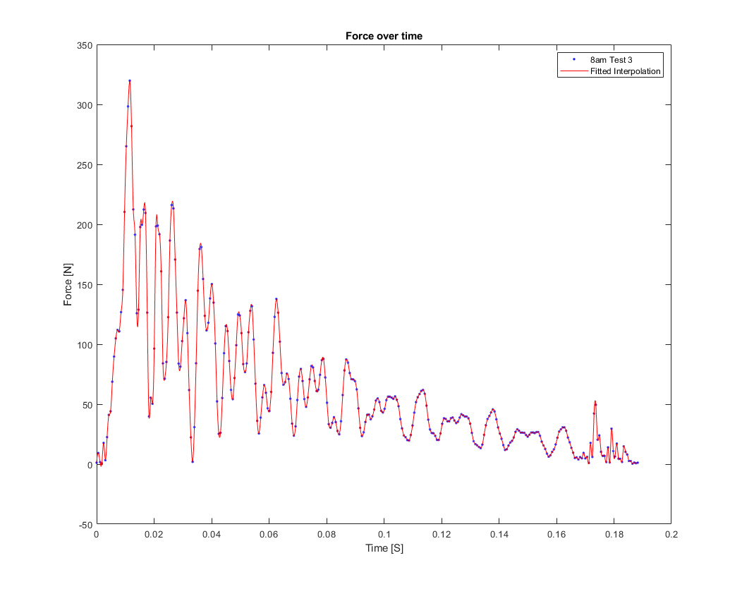
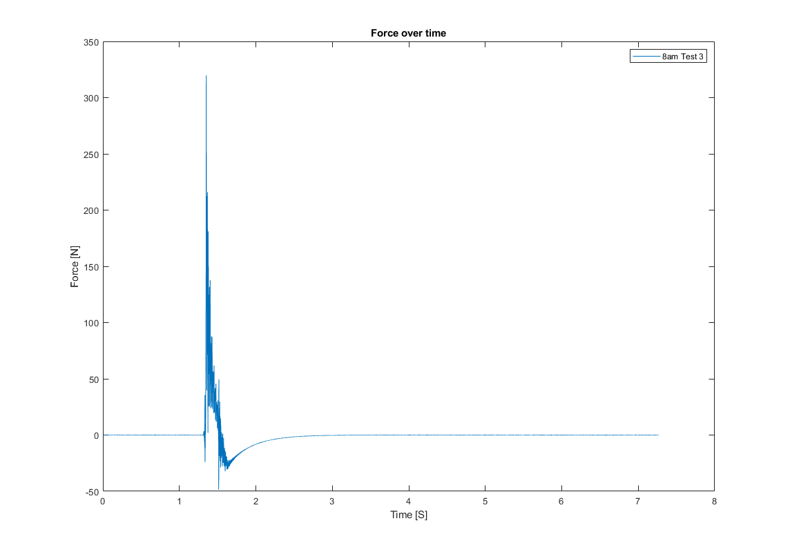
Initial Data → Cubic Interpolated Fit
Raw TA Static Test Stand Data
Cubic Piecewise Interpolation - Negative Values Mean shifted & removed - Trailing data removed
Notes:
Jashan: This slide shows the initial and final product of a sample data set. In the second picture, we see the cubic piecewise interpolation used in contrast to the smoothing spline interpolation method with the built in ‘fit’ function of Matlabs data fitting toolbox. The cubic interpolation does a better job of exactly tracking the points but also includes outliers more. Both the smoothing spline and the cubic interpolated fit produced almost exactly the same area, thus ISP, and thus distance of the rocket for the model so an in depth analysis to the benefits of one of the other was not performed.

Slide 9
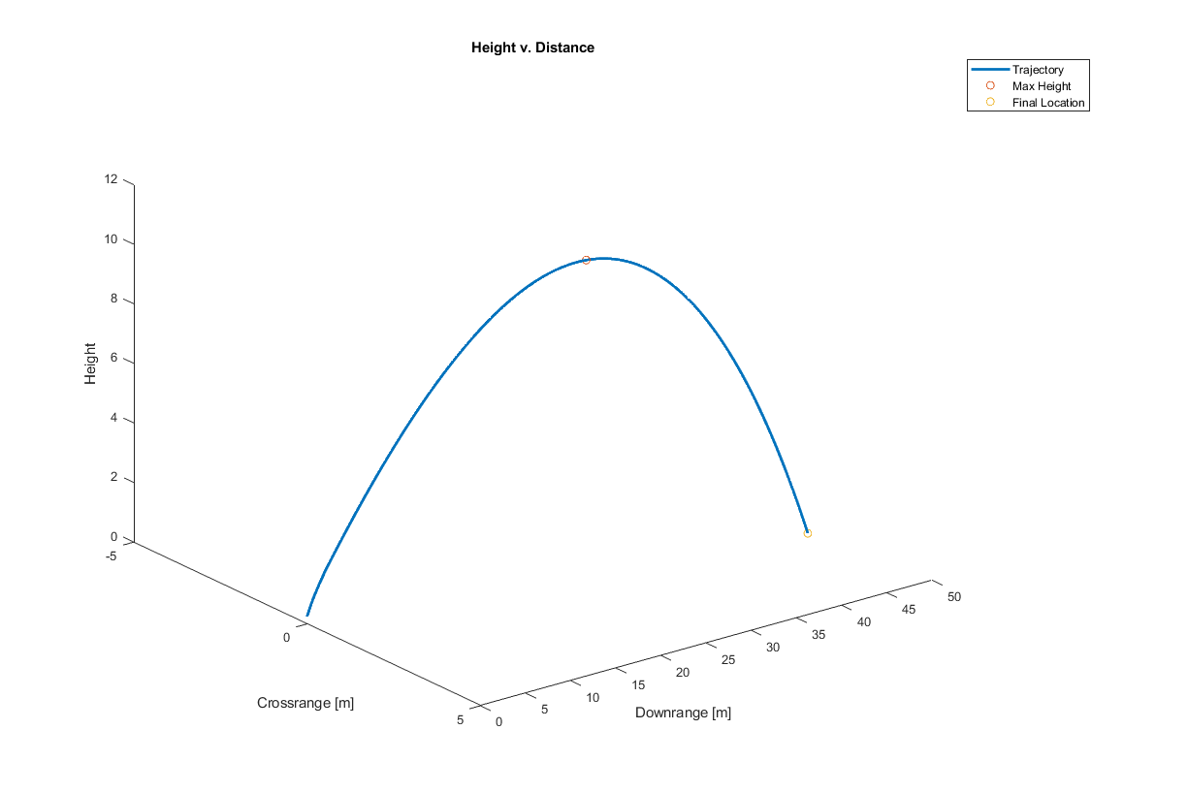
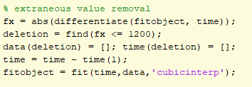
Direct Interpolation Model
The Direct Interpolation model replaces the force calculation in the thermodynamic model with the static test stand data
Approaches:
Built in ‘fit’ function creates a cfit object for direct time evaluation
Spline ‘interp1’ between actual data points for times in between data → could not align ode45 timestep and interp1
Notes:
Jashan: The direct interpolation model combines the first two models. The thrust data is brought into the main script and adjusted accordingly, fitted with the same cubic interpolation model as the second model. To calculate the thrust values at any given timestep of ode45 two methods were employed. The first was directly using the cfit object that was fitted to the data, plugging in time values. Linear interpolating between actual data points ended up being inaccurate because of the sinusoidal nature of the static test stand thrust curves. This model had two central issues so it was not used in accurately predicting the final destination of the rocket. Because of the rapid decrease in thrust values at certain points, the accelerations would lack, thus velocities and distances, making the final distance roughly a third of the distance in the thermodynamic case. In addition the stopping condition for ode45 was based on thermodynamic results and thus did not perfectly line up with the direct interpolation model, care was taken to as closely match the transition to the second stage as possible but it was not perfect.

Slide 10
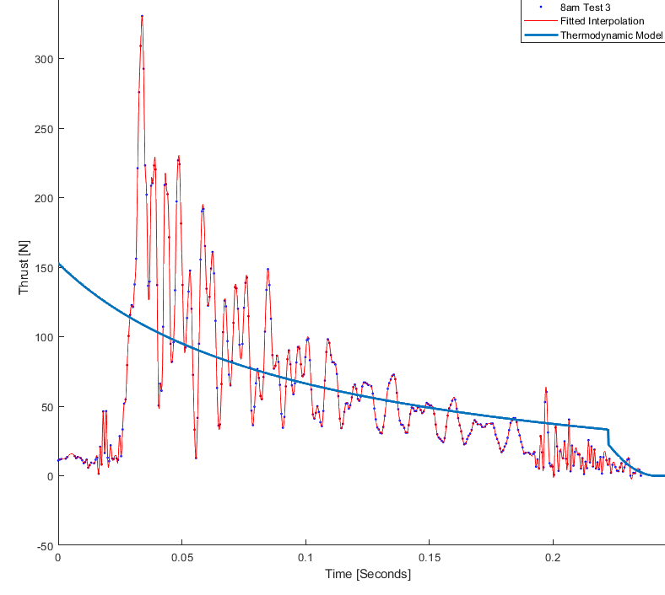
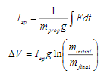
Thermodynamic Thrust v. Static Test Thrust
Notes:
Jashan: Here the thermodynamic model thrust is overlayed on top of the static test stand data. We can see that the thermodynamic model provides a relatively good average of the thrust over the given time span. This also illustrates why the thermodynamic model works better than the direct interpolation model, the low dips in thrust provide strange values for given ode45 timesteps and affect the end results. The smooth thermodynamic curve provides predictable results. The thrust near the end is far lower than the thermodynamic model, potentially showing why both the ISP and DI models fail to reach the full distance.

Slide 11
Launch Performance Comparison [TA Flight]
Actual = 57.8 [m] dist, ~4 [s], 10 [deg], 27.4 [m] max height | Predicted | Residual
Thermodynamic Model | 55.77 m | 3.33 s | 1.67 deg | 12.88 m | | 2.03 m | 0.67 s | 8.33 deg | 14.52 m |
Isp Rocket Model | 56.08 m | 3.81 s | 0.70 deg | 17.99 m | | 2.07 m | 0.19 s | 9.30 deg | 9.41 m |
Direct Interpolation Model | 48.29 m | 3.04 s | 2.22 deg | 10.56 m | | 9.51 m | 0.96 s | 7.78 deg | 16.84 m |
Challenges
Additional crossrange distance in actual testing
Different pressure distributions and thus drag on different faces
Friction from sides of rails if it was touching one would cause an initial angle
Fluctuation of static test stand data, and only one data set
Direct interpolation model was extremely sensitive to small static test stand data alterations
Section 011
8am
TA Launch 1
Notes:
V. Launch Performance Measurement – team effort, group presentation (part C)- compare predicted to measured TA baseline distance (time, altitude at zenith and drift)- compare measured parameters to payload acceleration and altitude data- identify and analyze uncertainties and mathematically define sources of error between calculated and actual results from TA baseline flight and validate payload accuracy- OBJECTIVE: compare empirical to predicted performance and characterize deltas
Sasha

Slide 12
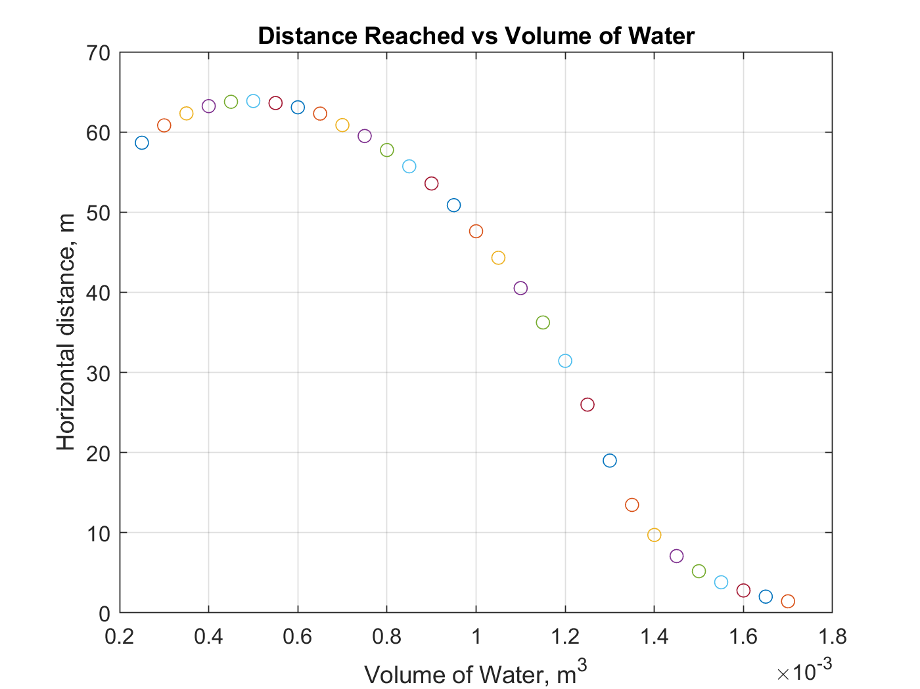
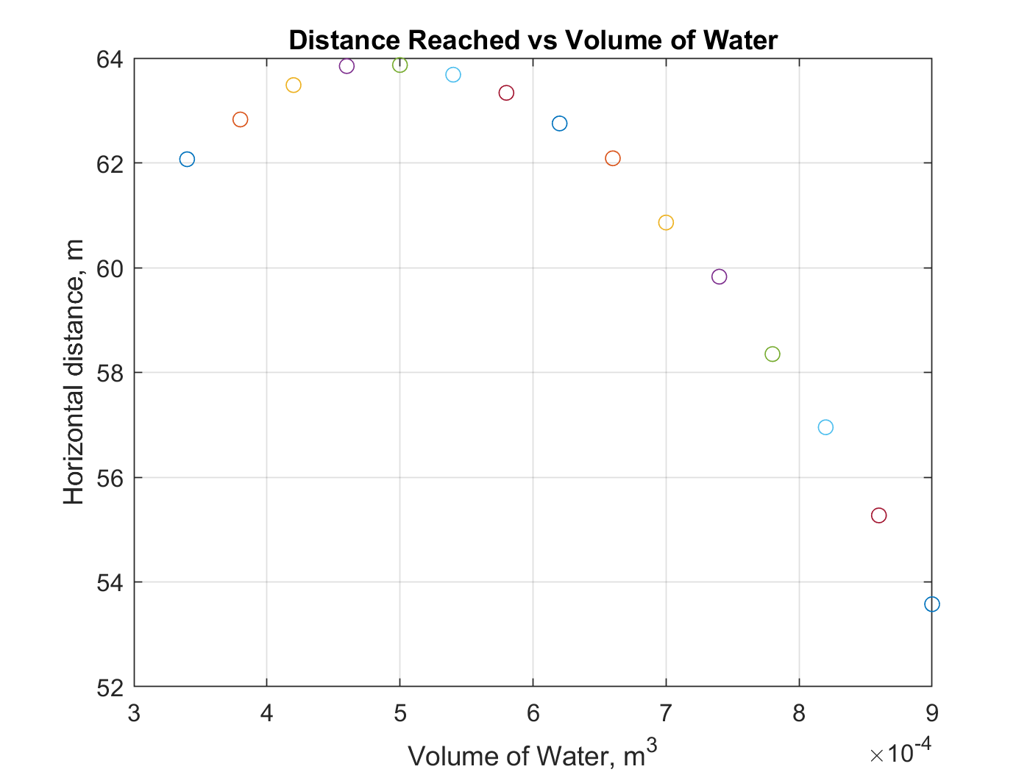
Sensitivity Analysis - Initial Volume of Water
TA: 1000mL
Ideal: 500 mL
Δx = 16m
200 mL to 1.7 L
Zoomed in, 300mL to 900 mL
Notes:
Dominic: It was found that initial volume of water in the rocket produced the biggest change in performance.

Slide 13
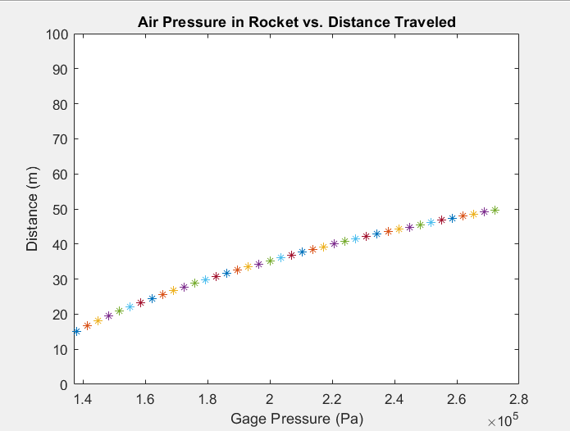
Sensitivity Analysis - Gage Pressure
Δx = 0m
Max distance increases with an increase in gage pressure
The total distance traveled was very sensitive to the starting gage pressure of the air in the bottle. In order to maximize distance we will use the maximum 40 psi allowed in the bottle rocket. Because this was already baseline, we didn’t change it
Notes:
Dominic

Slide 14
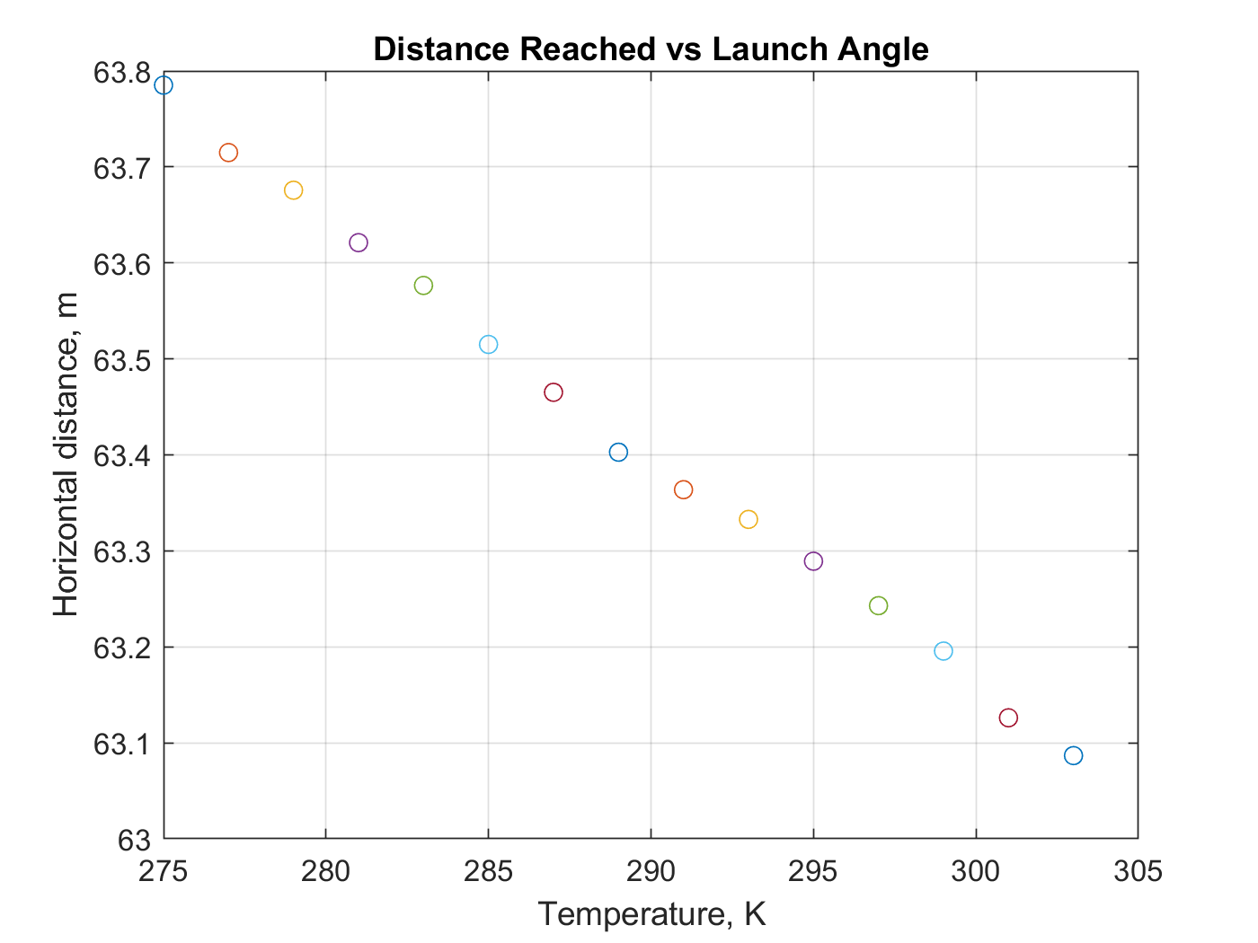
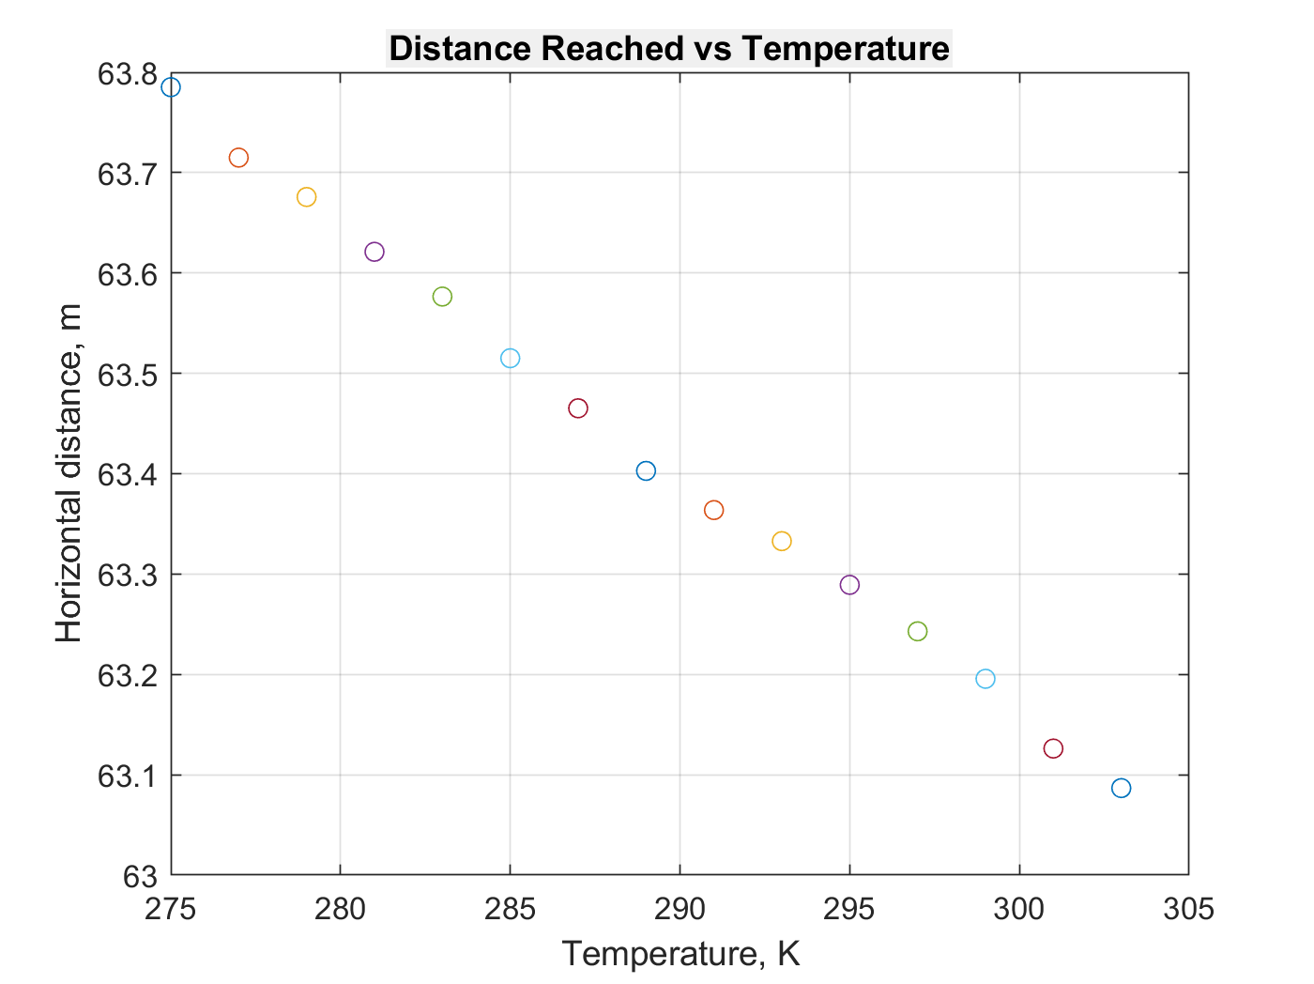
Sensitivity Analysis - Initial Air Temperature
Δx = 0m
Ideal: Distance increases with decreasing air temperature
The distance change was monumentally small for a huge temperature change, so we opted not to change it.
Notes:
Dominic

Slide 15
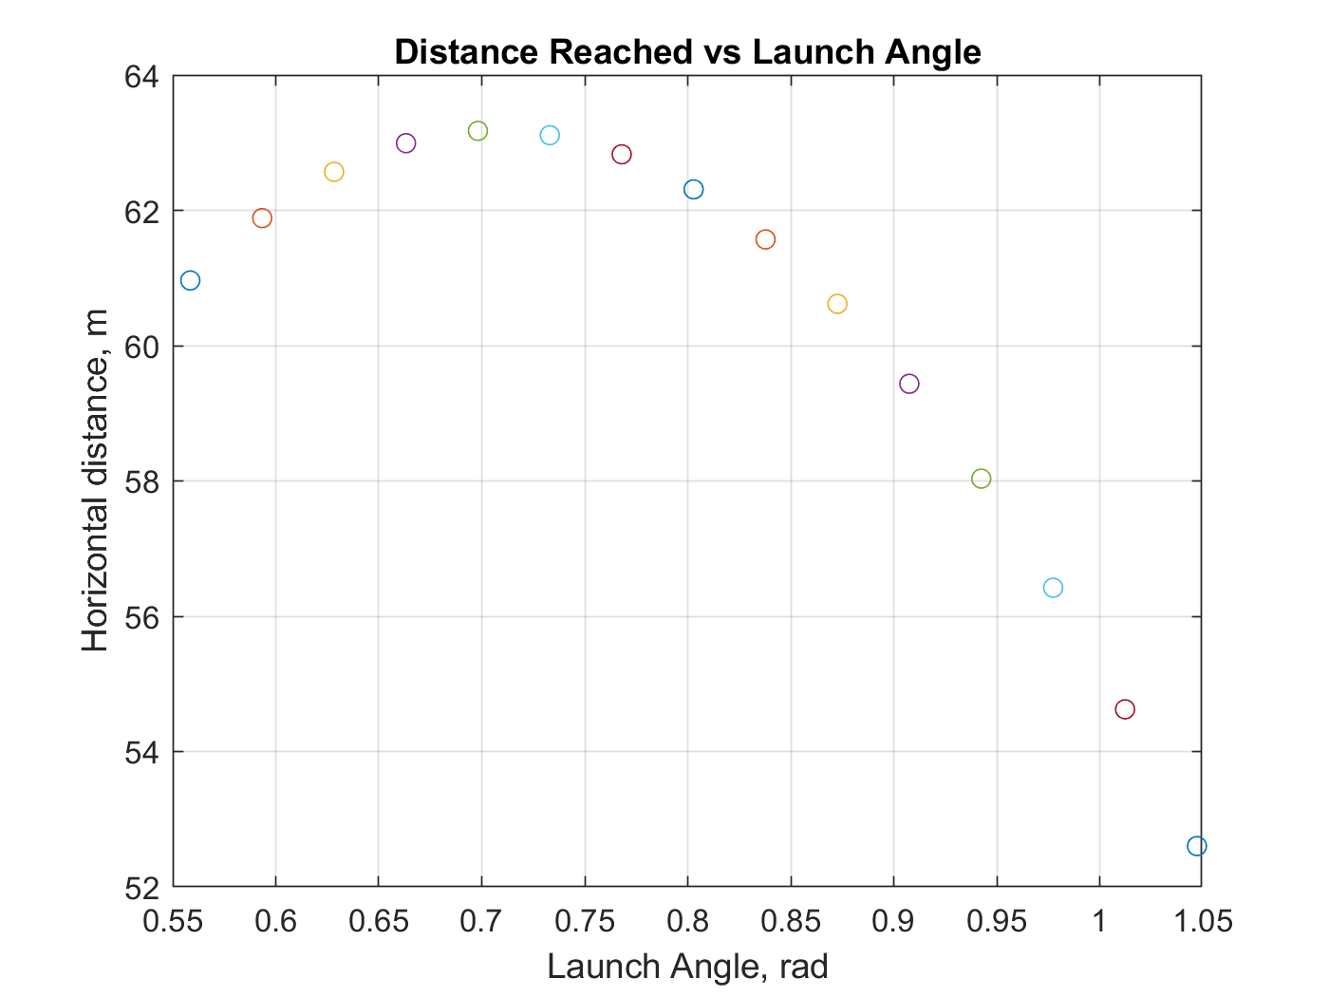
Sensitivity Analysis - Initial Flight Angle
Ideal: ~40 degrees
40 degrees was better than the 45 degree baseline, but only by roughly a meter.
Δx = ~0.5m
Notes:
Dominic

Slide 16
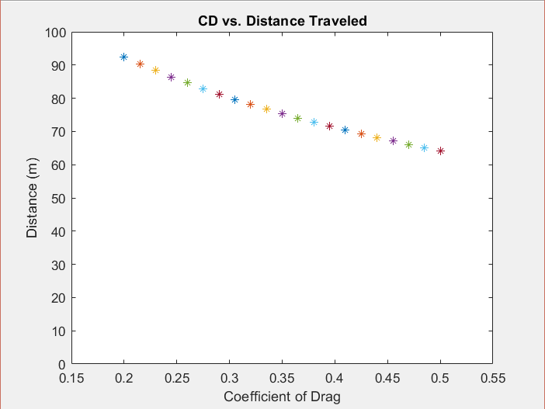
Sensitivity Analysis - Coefficient of Drag
Max distance increases with a decrease in CD
Total distance traveled was moderately sensitive to changes in the C_{D} of the rocket. In order to maximize distance we can reduce cross sectional frontal area of the rocket and make it as aerodynamic as possible.
Baseline: .3361
Δx = ~5m
(assuming .3 Cd min)
Notes:
Dominic

Slide 17
Final Design Modification
Design Modification: Coefficient of Drag
Why?
Volume of water had obvious best effect
Coefficient of drag let us explore design creativity and get more wind tunnel experience!
Modifications
Elliptical nose cone, better for subsonic rockets
Elliptical fins, lower induced drag.
TA Cd: .3361
Team Cd: .3773
Notes:
Seb

Slide 18

Wind Tunnel Data Analysis
C_{D} = D/(q∞A)
Use Sting Axial Force as the drag force
Calculate the mean of the drag coefficient for the three wind speeds (8, 15, 20 m/s)
Calculate the mean of the three values.
Notes:
Sasha

Slide 19
Normally Distributed Parameters
Every parameter was normally distributed at random with the mean being our desired initial conditions at launch.
Wind | Volume Water | Bottle Mass | Coefficient of Drag | Temperature of Air
10 mph | 100 mL | 10 grams | 0.5 | 10 degrees C

Slide 20
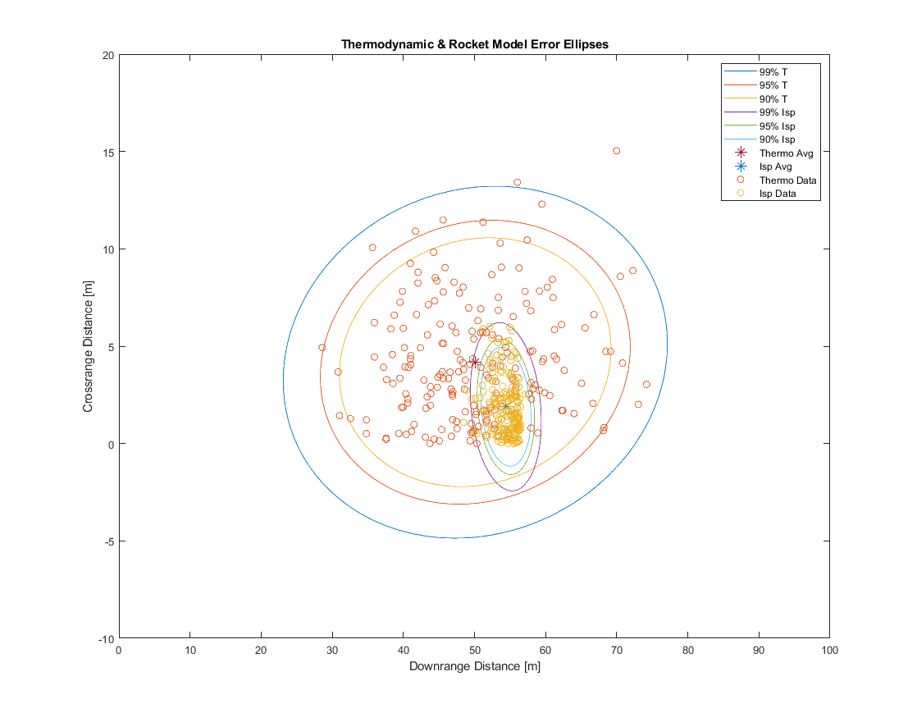
Monte Carlo Simulation: Pre-Launch
Launch 1
Trials: 200: Pre Launch Estimations
Dist: 55.58 m [avg]
Height: 15.29 m [avg]
Time: 3.72 s [avg]
Beta: 8.29 deg* [Therm Model]
Isp simulation is far more precise because of the usage of only one static test stand dataset. → mostly wind variability
Models severely underpredicted crossrange, low wind values in simulation, launch day was much higher
*Crossrange Angle (Beta) scaled by 2x
Notes:
Jashan: The monte carlo simulation gave us 99%, 95% and 90% error rings for both the thermodynamic model and the rocket equation model. The direct interpolation model was too susceptible to the initial conditions and the cutoff range set to automate the data trimming process. I initially had it removing values where the distance was obviously messed up, however there were too many NaN values to give a reasonable error ellipse. We noticed a couple things here, one being the small error ellipse on the ISP launch. This is because of the usage of only one static test stand dataset. Our launch was inside the 95% error ellipse for the thermodynamic model, but not for the Isp model. For the horizontal range it was very close to the mean in both cases, but we underpredicted our crossrange distance drastically in both cases. We realized this from analyzing the TA launches, and applied a 2x scaling factor for our actual pre-launch estimations, this still proved to not be enough, and we should probably have applied a 3x scaling factor to our estimation.

Slide 21
Launch 1
Range Increase: -1.5% -0.9 m → Slightly Worse
Flight was stable - rocket rotated as predicted by wind tunnel tests and did not visibly wobble
The chosen modification resulted in worse performance
Notes:
The biggest reason for decreased performance was the larger Cd. There could a number of factors that contributed to this. One could be as simple as the design itself. While all the research conducted over the course of this lab pointed to a parabolic nose cone reducing the Cd value, it in fact increased the drag associated with our rocket. It is important to note however that there may have been other factors as well such as the fin thickness and manufacturing quality that affected the Cd value of the rocket.
JACOB

Slide 22
Comparison to Models [Launch 1]
 | Predicted | Residual
Thermodynamic Model
Isp Rocket Model Estimate greatly improves w/ TA static test stand data
Direct Interpolation Model
Dist = 56.9 m | Alt = 18.9 m
Beta = 13 deg | Time = 4.07s
Dist = 51.43m | Alt= 11.29m
Beta = 3.1 deg | Time = 3.13 s
Dist = 5.47m | Alt = 7.61m
Beta = 9.9deg | Time = 0.94s
Dist = 42.2 m | Alt = 12.98 m
Beta = 1.1 deg | Time = 3.23 s
Dist = 14.7 m | Alt = 5.92m
Beta = 11.9deg | Time = 0.84s
Dist = 50.89m | Alt = 10.84m
Beta = 6.7 deg | Time = 3.09 s
Dist = 6.01m | Alt = 8.06m
Beta = 6.3deg | Time = 0.98s
After plugging in launch day values → Every model had a strong aspect!
The Isp model gives better results with more static test data
Notes:
After launch day, we plugged in our initial conditions to the three different models, and found some interesting results. To start, all three models actually underpredicted the final distance of the launch. One of the possible reasons for this is that the wind measurement was not perfectly accurate, as it was changing rapidly on the launch day. Our monte carlo simulation accounted for high variability in wind, and thus gave us better predictions closer to launch. The wind we recorded right before launch may have changed during launch. Just as strange was that each model had something better. The thermodynamic model, as expected, provided a best estimate of the final distance just because of the uncertainty with the static test stand data. However, using the actual thrust data in both the ISP and the DI models gave us a better time and altitude measurement, and a better beta uncertainty angle. I think in both cases the initial high thrust early on gave us a better beta angle starting out which carried on throughout the launch.
JACOB

Slide 23
Launches 2, 3
Launch 2 - Range Increase: -7.17% -3.8m → Worse
Launch 3 - Range Increase: -10% -5.5 m → Significantly Worse
Same design, ≈500mL of water, 45º launch angle
Deterioration of rocket integrity
Wrinkled nose cone increased C_{D}
Fin wobble
Deterioration of tape holding fins to rocket body
Launch error
String detached from the release key - delayed launch from altimeter start (2)
Data?
Data was collected but was unusable - MATLAB GUI wouldn’t run with the data
Notes:
JACOB

Slide 24
Sources of Error
Static test stand data has multiple inconsistencies → Better estimates from using averages from multiple data sets → Better ways to fit the data?
DI model was extremely prone to static test stand cutoff values → Could not use in monte carlo → May have given us a better crossrange angle estimate
Moments or friction generated from the launch stand could have contributed to a higher crossrange angle
Wind was not constant throughout the whole launch, changed directions and speed rapidly
Deterioration in rocket increased coefficient of drag as increased launches occured
Uses an idealized thermal expansion model and cannot account for more complex thermal interactions (changes in temperature in actual conditions) → not able to fix at our level
Turns out predicting a rocket launch is hard!
Notes:
Seb

Slide 25
Thanks!

